Slide 1
BMES 550: Advanced Biocomputational Languages
Heart Disease Risk Calculator
Group 25
Caitlyn Christopher, Will Cocos, Garrett White
1
Notes:
Cait

Slide 2
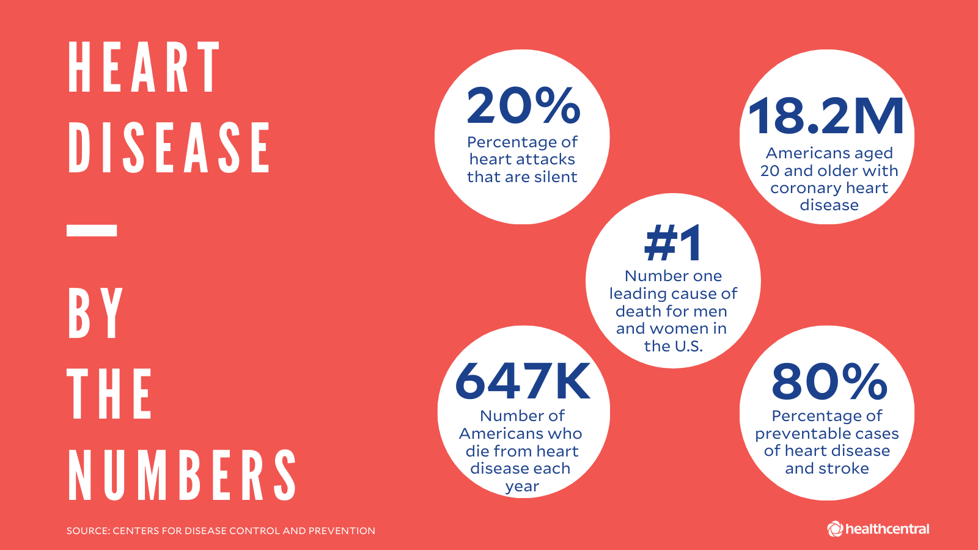
Problem Description and Motivation
Heart disease remains the leading cause of death in the United States
~697,000 people die every year: 1 in every 5 deaths^{[1]}
Atherosclerotic cardiovascular disease (ASCVD) affects ~18 million worldwide^{[3]}
There is a need for patients to estimate their 10-year heart disease risk as a reference point prior to an initial appointment^{[4]}
There is a need for patients to determine, based on risk severity, where hospitals are in reference to location
Figure 1: Heart Disease Statistics^{[2]}
Cait 2
Notes:
Cait

Slide 3
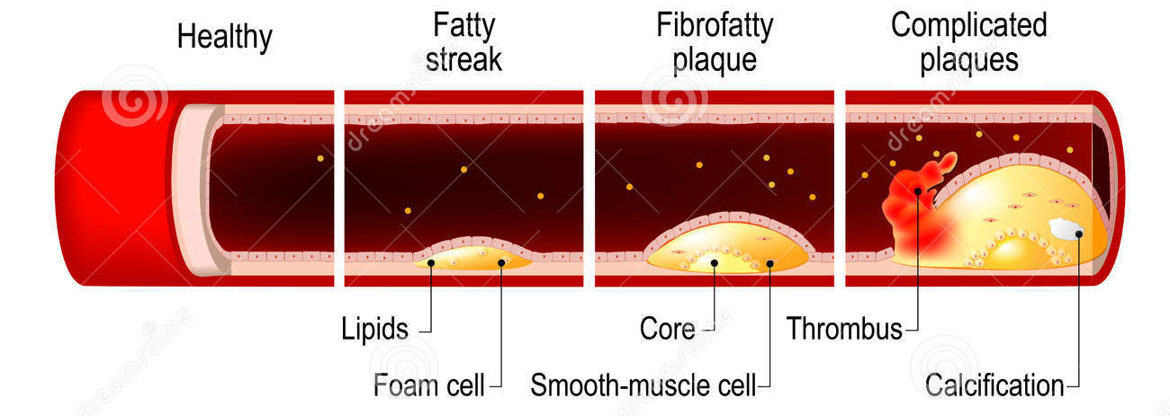
Biology & Physiology of ASCVD
ASCVD involves the buildup of cholesterol plaque in the arteries
Refers to conditions including coronary heart disease (CHD), coronary artery stenosis, and angina^{[6]}
Risk factors include high blood pressure, low LDL, diabetes, smoking history, age, and sex^{[6]}
Figure 2: Stages of ASCVD^{[9]}
Cait 3
Notes:
Cait

Slide 4
Introduction
Garrett 4

Slide 5
Goals
A graphical user interface (GUI) will be developed that enables an individual to obtain their risk for ASCVD
Will allow the user to input: sex, race, age, presence of blood pressure medications, blood pressure values, cholesterol, high-density lipoprotein (HDL) cholesterol, smoking status, and presence of diabetes
User will be able to input their current zip code
Based on input factors, the calculator will present a risk score of ASCVD as a percentage (##.##%)
Based on entered zip code, the GUI will determine the three closest hospitals from their location along with the distance to each hospital
Garrett 5
Notes:
Garrett

Slide 6
Users & Influence
Target End Users
Primary users are those who are between the ages of 40 and 75 years of age and are at risk for ASCVD
Secondary users are 21 to 39 and 76 and older, as users in these age groups are typically at lower risk^{[7]}
Influence
Can provide users with a baseline risk for ASCVD prior to an appointment with their physician
Can provide users appropriate resources (i.e., hospitals near them) to make a decision if they or a family member feel they are in dire need
This could be the difference between life or death for the patient
Garrett 6
Notes:
Garrett

Slide 7
Methods & Experiments
Cait 7

Slide 8
Equations
The Pooled Cohort Equations (PCE) are sex and race specific tools that help estimate 10-year risk of ASCVD
These equations were implemented into the GUI to determine the user’s risk based on a variety of inputs
They are modified depending on age, race, and whether or not the user takes prescribed blood pressure medication^{[8]}
Cait 8
Notes:
Cait

Slide 9
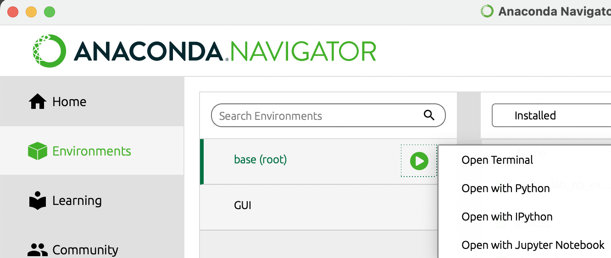
Software Utilized
Step A
streamlit through Anaconda
Go to Anaconda-navigator
On the left-hand side, go to “Environments”
Press play button next to “base-root”
Open terminal
Step B
Step C
Step D
Cait 9
Notes:
Cait

Slide 10
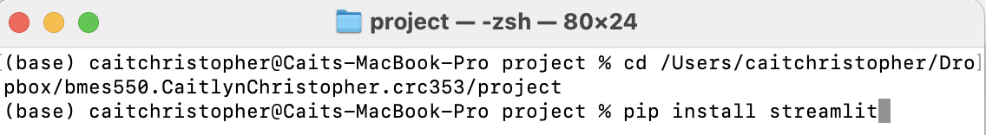
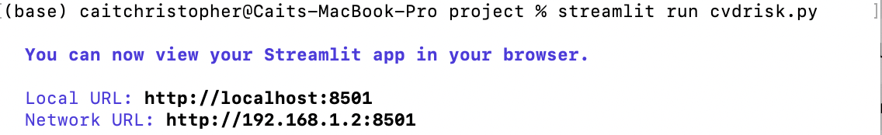
Software Utilized Cont.
Step A
Prompts in Terminal
Navigate to file folder using “cd”
“pip install streamlit”
“pip install geopy”
“streamlit run cvdrisk.py”
Step D
Step C
Step B
Cait 10
Notes:
Cait

Slide 11
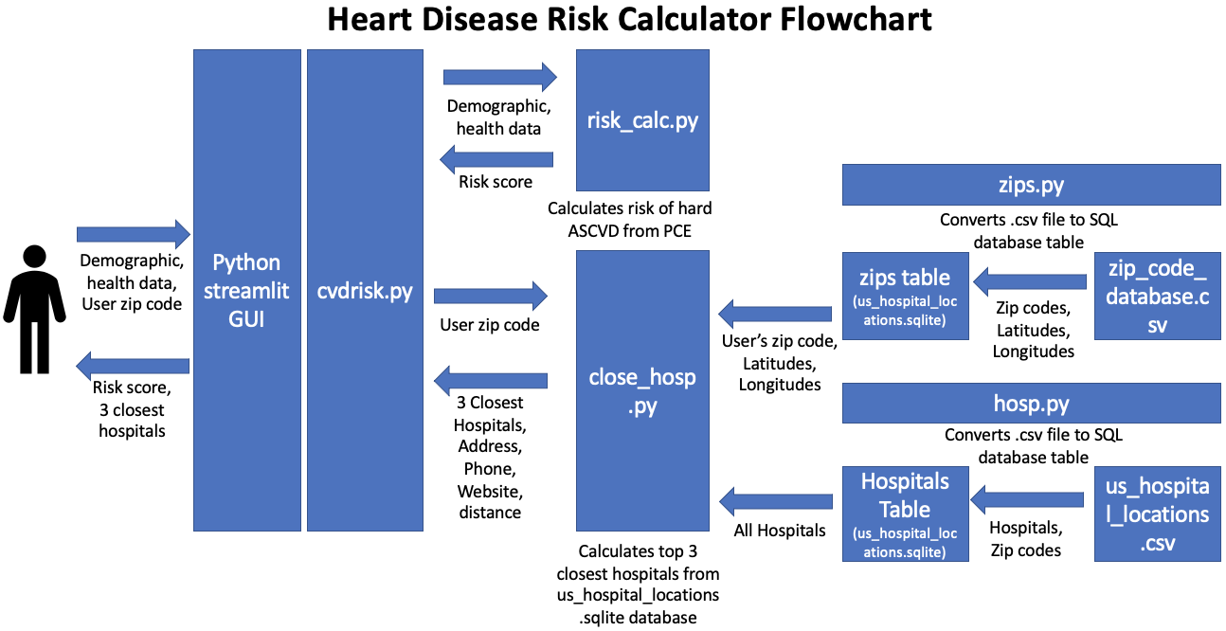
ER Diagram
Will 11
Notes:
Will
Cdvrisk.py is a relationship (denoted by diamond)
Risk_calc and close_hosp are weak relationships (denoted by double diamond)
Zips.py with table and .csv are a weak entity (denoted by box)
Hosp.py with table and .csv are a weak entity (denoted by box)
Weak entity is reliant on another entity

Slide 12
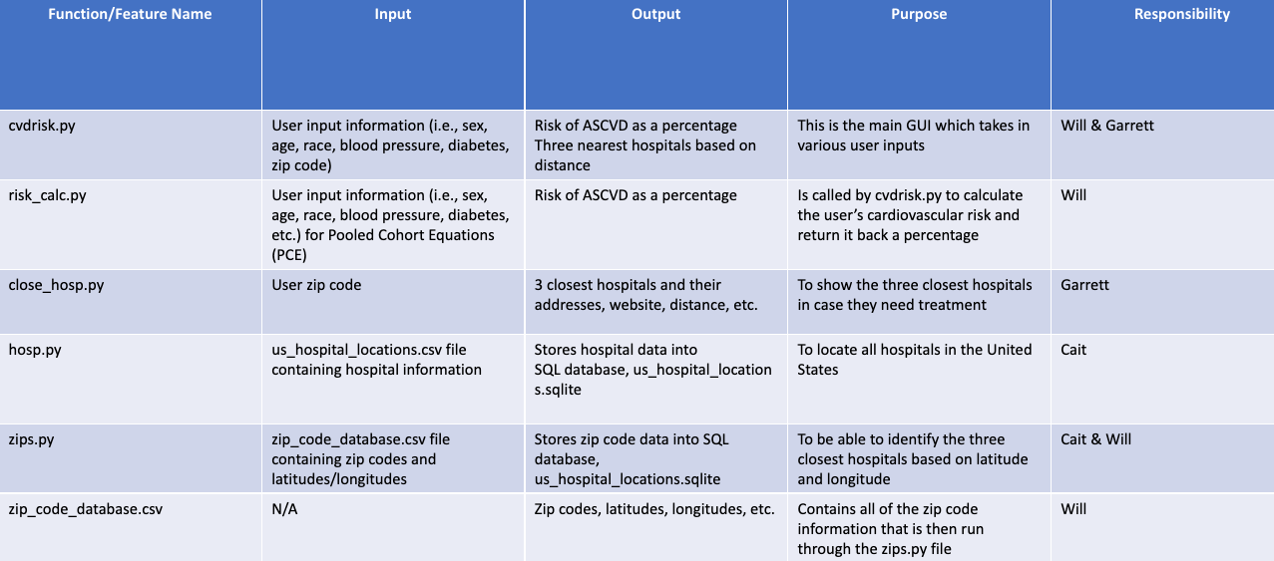
GUI File Table
Will 12
Notes:
Will

Slide 13
Demonstration & Results
Cait 13
Notes:
Will

Slide 14
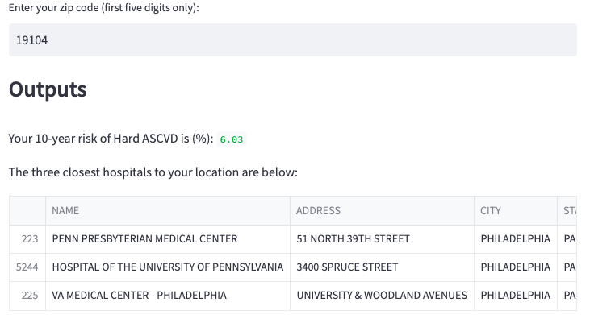
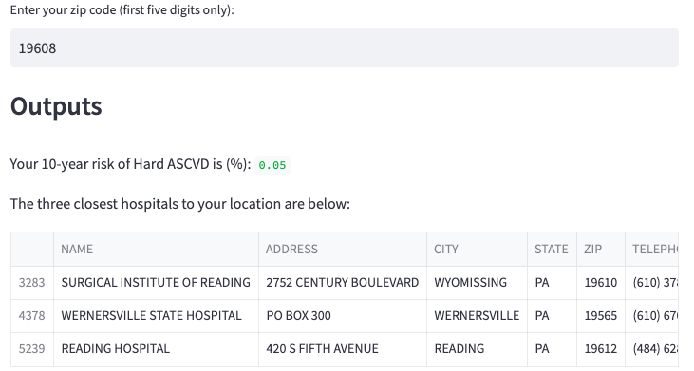
Example Outputs
Different input values result in different 10-year risks of ASCVD
Different zip code entries result in 3 hospitals closest to that location
Cait 14
Notes:
14

Slide 15
Discussion
Garrett 15

Slide 16
Limitations
Race is factored into our calculator
Has been shown to change scores even if two individuals of different race have the same overall risk [5]
Downloading data url’s
The sources from which we received our data in regards to zip code and coordinate systems are only temporary available and cannot be permanently implemented
Garrett 16
Notes:
Garrett

Slide 17
Future Additions
Implement our own database
Would be great to store everyone’s risk so the individual can see where they range among all users
Would eventually like to then sort all the results by location to see if geographic locations factor into cardiovascular risk
Garrett 17
Notes:
Garrett

Slide 18
References
[1] Heart Disease and Stroke Prevention. (2019). Ny.gov. https://health.ny.gov/diseases/cardiovascular/heart_disease/#:~:text=About%20697%2C000%20people%20die%20of,Americans%20have%20a%20heart%20attack.
[2] What is Heart Disease? And Other Heart Disease Questions. (2020, May 19). Healthcentral.com. https://www.healthcentral.com/condition/heart-disease
[3] World. (2021, June 11). Cardiovascular diseases (CVDs). Who.int; World Health Organization: WHO. https://www.who.int/news-room/fact-sheets/detail/cardiovascular-diseases-(cvds)
[4] Atherosclerotic Cardiovascular Disease Risk Markers | Choose the Right Test. (2022). Arupconsult.com. https://arupconsult.com/content/cardiovascular-disease-traditional-risk-markers
[5] Variations emerge in clinical cardiovascular disease risk calculator. (2022, January 5). NHLBI, NIH. https://www.nhlbi.nih.gov/news/2022/variations-emerge-clinical-cardiovascular-disease-risk-calculator
[6] Atherosclerotic Cardiovascular Disease Risk Markers | Choose the Right Test. (2022). Arupconsult.com. https://arupconsult.com/content/cardiovascular-disease-traditional-risk-markers
[7] AlQuaiz AM, Kazi A, Alodhayani AA, Almeneessier A, AlHabeeb KM, Siddiqui AR. Age and gender differences in the prevalence of chronic diseases and atherosclerotic cardiovascular disease risk scores in adults in Riyadh city, Saudi Arabia. Saudi Med J. 2021 May;42(5):526-536. doi: 10.15537/smj.2021.42.5.20200684. PMID: 33896782; PMCID: PMC9149694.
[8] Goff, D. C., Lloyd-Jones, D. M., Bennett, G., Coady, S., D’Agostino, R. B., Gibbons, R., Greenland, P., Lackland, D. T., Levy, D., O’Donnell, C. J., Robinson, J. G., Schwartz, J. S., Shero, S. T., Smith, S. C., Sorlie, P., Stone, N. J., & Wilson, P. W. F. (2014). 2013 ACC/AHA Guideline on the Assessment of Cardiovascular Risk. Circulation, 129(25_suppl_2). https://doi.org/10.1161/01.cir.0000437741.48606.98
[9] What is ASCVD | Canadian Heart Patient Alliance. (2021). Heartpatientalliance.ca. https://www.heartpatientalliance.ca/general-information/types-of-cardiovascular-disease/what-is-ascvd/
‌
‌
‌
‌
‌
‌
‌
18

Slide 19
Thank You
Any Questions?

